Slide 1
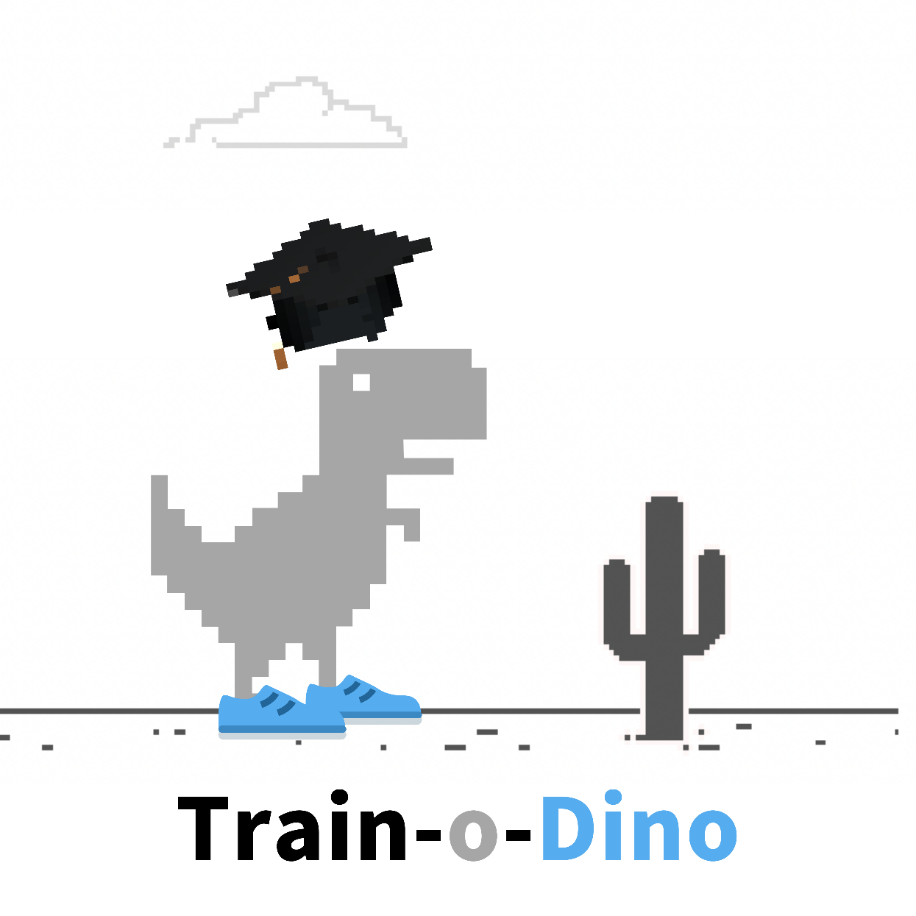
Project Detailed Presentation
Arunpriya Gobinath || 100841238
Jugnu Shefin || 100814025
Ramasubramanian Dharumaperumal || 100810343
Raj Dholakia || 100813041
Sourabh Potdar || 100844478
Product Manager: Marcos Bittencourt

Slide 2
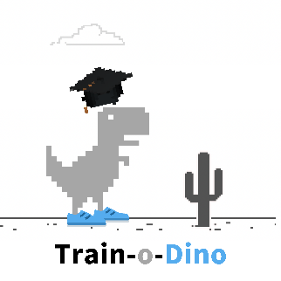
Table of Contents
Problem Description
Solution Description
Project Scope and evaluation
Technologies
Project usecases

Slide 3
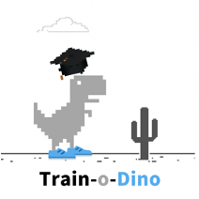
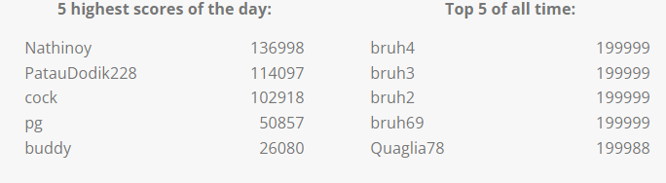
Problem Description - AP
What is the Dino Run game?
When our internet connection goes down and we feel like a Neanderthal, Google understands our plight and provides some fun entertainment to pass the time while our connection to the World Wide Web is resurrecting: Chrome dinosaur offline game!
It is a primitive endless runner game in the Chrome browser. The protagonist is a charming little T-Rex dinosaur who is running through an ancient desert.
What is the goal of the Game?
Of course, the dinosaur game has its purpose: to avoid cacti and pterodactyls. Though the game seems easy, it does not take long to get hard because the game’s speed will be constantly increasing as our progress further
How to play the game?
On both desktop and mobile, the game may be played in the Chrome browser. The control is the simplest: When the black dinosaur appears in our browser, suggesting that there is no Internet connection, we just hit the spacebar to begin the game. Jumping over obstacles is also done with the spacebar. To duck, use the down arrow. If we're on a mobile device, simply tapping the little Chrome Dino will activate it and help it avoid obstacles.
Why should train this Dino?
If we are trying to create AI, why not try to see how these algorithms perform at playing games? Games can be learnt from scratch – with usually a simple goal (of survival in this case).
Training a virtual agent to outperform human players can teach us how to optimize different processes in a variety of different and exciting subfields. By better understanding different aspects of intelligence, we can use this knowledge as inspiration to build novel computer systems that learn to find solutions to difficult problems on their own.
What are the high scores like?
Source : (https://chromedino.com/)

Slide 4
Solution Description
Use of reinforcement algorithm
We will create a base model using multiple online resources.
Algorithm
- The algorithm would describe a high-level overview of the steps to be undertaken.
Achieving the current position of the Dino in the game.
Preparing the data to be fed into the Machine Learning model.
Q-Learning Reinforcement learning algorithm to be used.
How is the model going to be trained?
Cloud Services
Two ways to use cloud computing for the project
Train and test the performance of the model on the cloud – there might eb a cost associated.
Create a website, a playground for hyperparameter tuning for the model.

Slide 5
Project Scope
The main goal is to develop an algorithm that scores more than 10000+ (highest category on the website) on the Dino Game.
In-scope deliverables
A chrome extension with a simple user interface.
Acquire, clean and prepare the data for training the machine learning algorithm.
Design, build and deploy the machine learning algorithm to successfully classify the spoiler from a text extract.
Create a prototype by integrating the machine learning model to the browser extension.
Out-of-scope deliverables
Gaining users for the extension.
Data collection for model training.

Slide 6





Technologies to be Used
Python
Machine learning libraries : Scikit-learn, TensorFlow, Keras
HTML/CSS/JavaScript for building the browser extension
Selenium
Git and GitHub for code management and version control.

Slide 7

Future Scope Use case for the users to
The goal is to create a Chrome web browser extension that works in a similar way to Spoiler Protection 2.0.
Expected features
Ability to selected from a pre-defined list of movies. If the desired movie option does not exist, add name of the movie manually.
Ability to switch between three modes:
Extension OFF – Do not hide any spoilers.
Hidden Mode – hide specific parts of a webpage.
Pop-up Mode – have a pop-up appear when visiting a webpage with spoilers.
Option to select a background color to hide spoilers (only in Hidden Mode).
Project acceptance criteria
Successful development of chrome extension to block spoiler text.
Successful development of machine learning model to classify spoiler text.

Slide 8

Thank you!

